Slide 1



WIS2DOWNLOADER
Peter Mutai
Kenya Meteorological Service Authority
15th SEPTEMBER 2026

Slide 2

What is WIS2 Downloader?
An open-source tool for automated data acquisition from WIS2.
Subscribes via MQTT
Connects to WIS2 Global Brokers.
KEY DESIGN GOALS
Automatic downloads
Pulls meteorological data files as notifications arrive.
Ease
Reliability
one command to start
dedup · SHA-512 · multi-queuing
Flexibility
wildcards · filter rules · multi-broker
Containerised deployment
Docker & Docker Compose.
Observability
Prometheus · Grafana
Audience
NMHSs, researchers, WIS2 node operators.

Slide 3
Key features.
Multi-language Web UI
EN · FR · ES · AR · ZH · RU
Automatic deduplication
Redis tracks notification IDs.
REST API
Programmatic subscription management.
SHA-512 verification
File integrity checked on every download.
MQTT topic wildcards
File organisation
DownloadPath/YYYY/MM/DD/<filename>
+
single level ·
#
multi-level
Topic search
UI browses the GDC catalogue directly.
Metrics & dashboards
Prometheus + Grafana out of the box.
Filtering
Pre- and post-download rules by media type or custom condition.
Horizontal scaling
Multiple workers or subscriber instances.

Slide 4









Key software and standards.
Workers
Main Language
API
Logging
DB
UI

Slide 5
WIS2 Downloader Stack

Slide 6
System requirements.
SOFTWARE
Docker 20.10 or later Docker Compose 2.0 or later
HARDWARE · MINIMUM FOR PRODUCTION
4 GB RAM (8 GB recommended) Sufficient disk space for downloaded data
NETWORK
Outbound access to the WIS2 Global Broker on port 443 (MQTT over TLS).
Internal access to ports 8080 (UI), 5002 (API) and 3000 (Grafana)
PERMISSIONS
Linux — downloads dir owned by the user and group configured
Windows / macOS — Docker handles volume permissions

Slide 7
Installation.
01
Download latest release
wget https://github.com/World-Meteorological-Organization/wis2downloader/archive/refs/tags/v1.0.0b1+rc4.tar.gz tar -xzf v1.0.0b1+rc4.tar.gz
cd wis2downloader-*
bash setup.sh
02
Run the setup script
03
Start all services
docker compose up -d
setup.sh
generates
.env
with a random
FLASK_SECRET_KEY
and REDIS_PASSWORD.

Slide 8
First steps after launch.
Web interface http://BASE_URL
Browse the WIS2 catalogue or topic tree · create your first subscription.
REST API http://BASE_URL:5002
POST /subscriptions
to create a subscription programmatically.
Grafana dashboard http://BASE_URL:3000
Monitor download counts, bytes and queue length in real time.
Verify downloads
Files appear in
downloads/YYYY/MM/DD/
immediately.

Slide 9
Web interface.
SIX MAIN VIEWS
Catalogue search
Queries three GDC (Global Discovery Catalogue) endpoints. Full-text and faceted search.
Navigate with
Dashboard Tree
Alt+1
through Alt+7.
Catalogue
Manual Subscription Settings
Topic tree browser
Hierarchical view of all available WIS2 topics.
Manage Subscriptions Documentation
Language switcher
English · French · Spanish · Arabic · Chinese · Russian.

Slide 10
Understanding WIS2 topics.
MQTT TOPIC HIERARCHY
{origin|cache}/a/wis2/{centre-id}/data/{data-policy}/{domain}/...
WILDCARDS DATA POLICIES
+
matches a single topic level
matches all remaining levels (must be last)
core — freely available, no restrictions
recommended — available with conditions
#
EXAMPLE SUBSCRIPTIONS
origin/a/wis2/+/data/core/# # all core data from any centre
origin/a/wis2/ro-roshydromet/data/core/weather/surface-based-observations/#

Slide 11
How does WIS2 Downloader handle metadata?
GDC connection
Fetches WCMP2 records from a WIS2 Global Discovery Catalogue on startup.
Local cache
Records stored locally · used to resolve topic paths and dataset names.
Refresh
Metadata can be reloaded at any time from the Settings tab.
Explore
Records can be explored and used for subscriptions in some views.

Slide 12
Finding data on WIS2.
Searching metadata records and subscribing in WIS2 Downloader.

Slide 13
The Catalogue View.
F I NDI NG DAT A
Search
Filter datasets by keyword, centre, data type and/or geographical information.
Browse
Each entry shows dataset title, WTH and location on the map.
Check
Check the metadata record and/or License agreement.
Subscribe
Select a dataset to expand its details and activate a subscription.
Use case
Finding datasets directly by using filters to find a specific one.

Slide 14
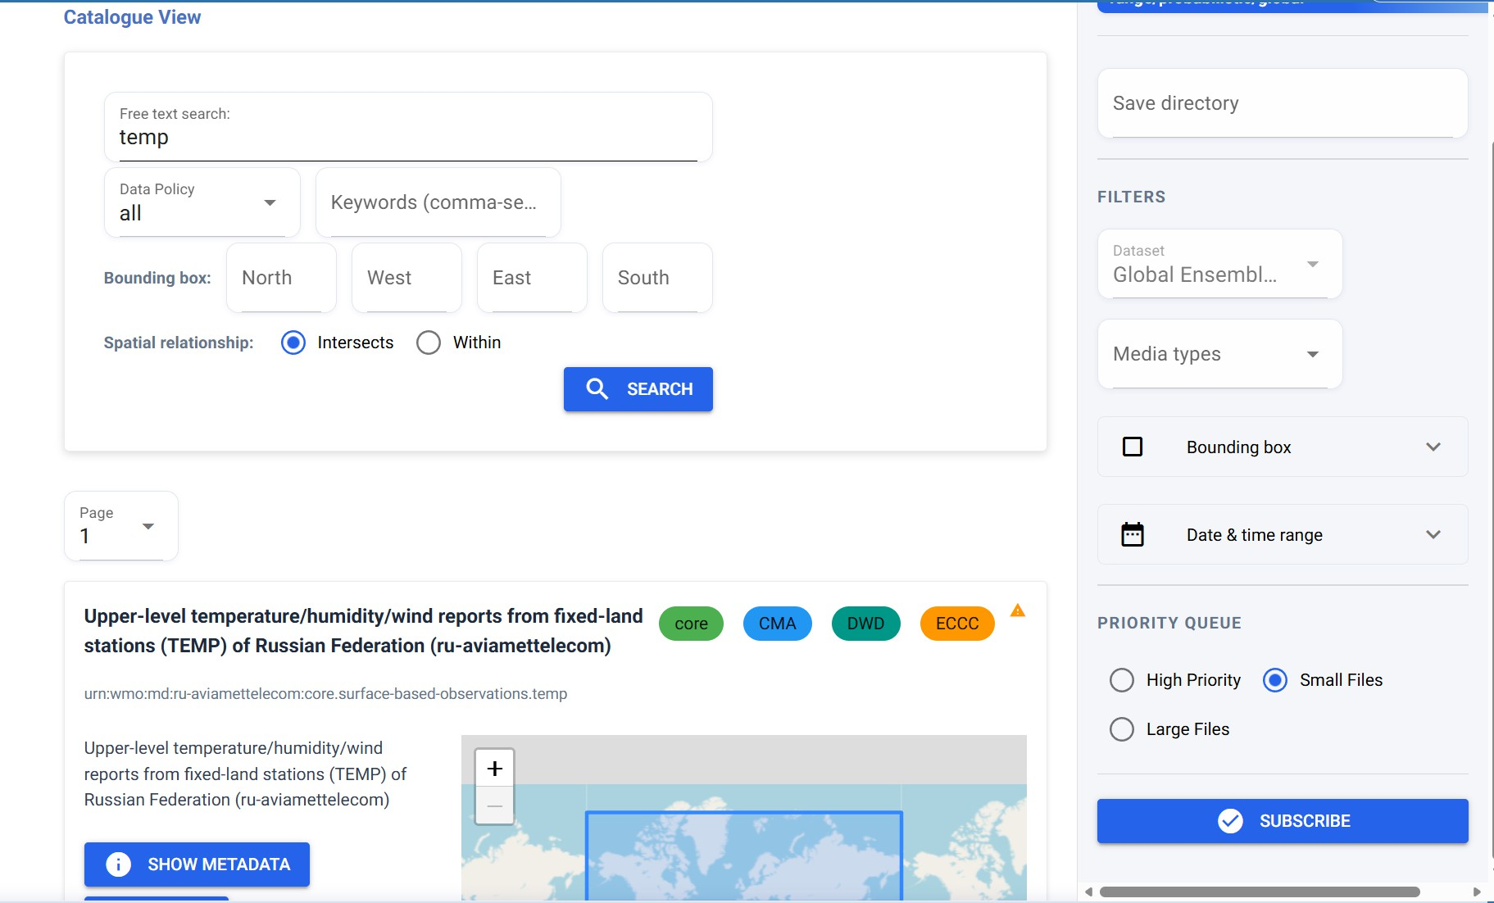
The Catalogue View.

Slide 15
The Tree View.
Navigate
Expand the topic hierarchy to drill down to a specific dataset or centre.
Wildcard support
Subscribe to a parent node to capture all child topics beneath it.
Subscribe
Click any node to view the full topic path and activate a subscription.
Use case
Find a topic from a top-down approach, easier for making subscriptions of broad range, e.g.: all surface observations of a country.

Slide 16
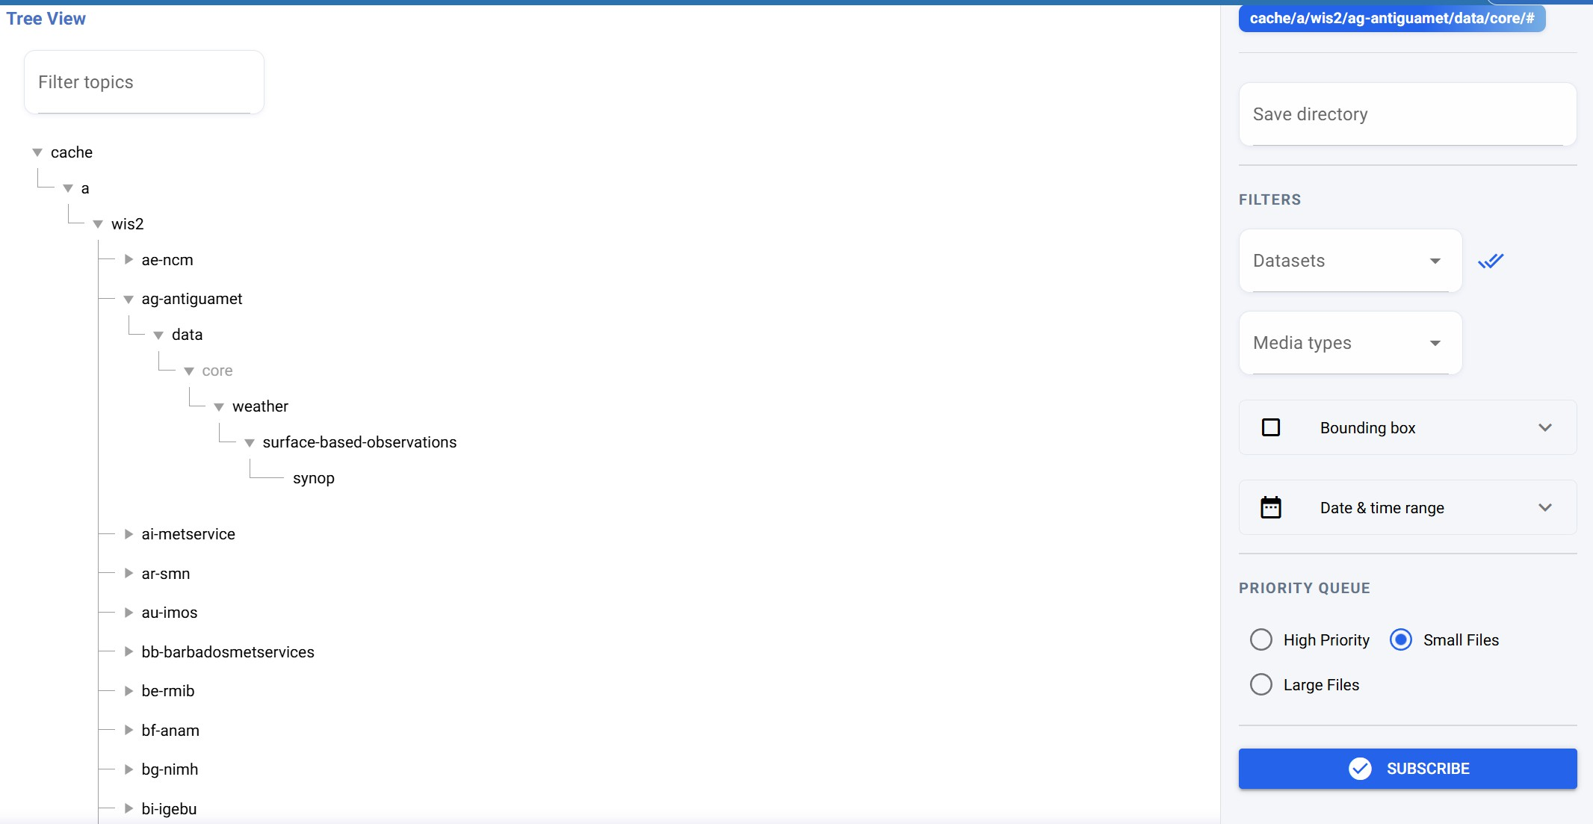
The Tree View.

Slide 17
Management.
Editing and deleting subscriptions, reloading metadata records.

Slide 18
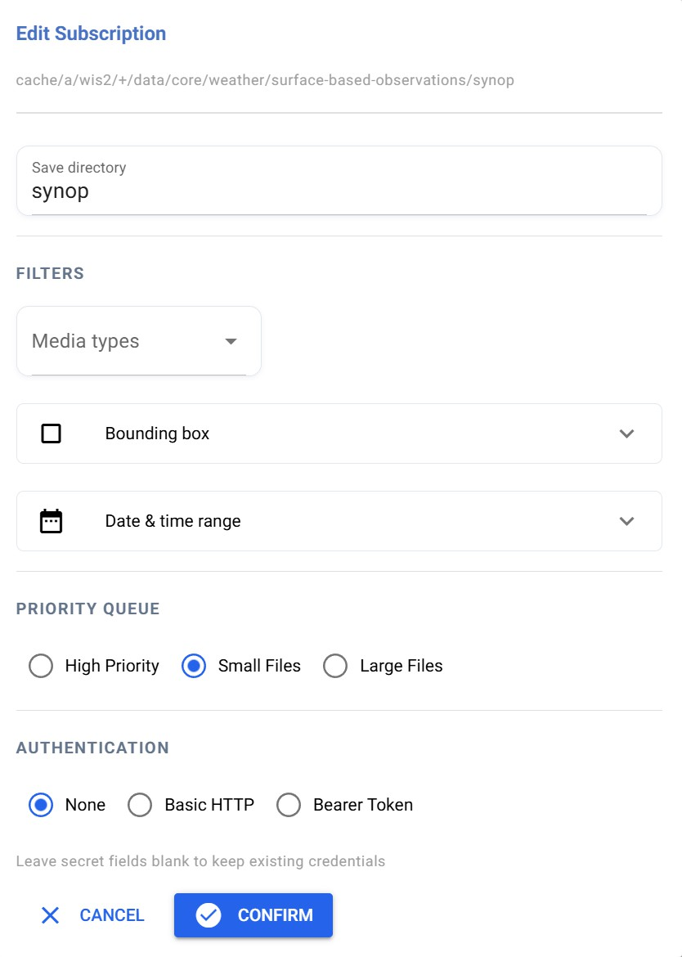
Editing subscriptions.
SUBSCRI PT I O N M AN AG EM ENT
Select
Click the Edit icon next to an active subscription in the Management tab.
Modify
Update filter rules · target directory · additional download options.
Apply
Changes take effect immediately · no restart required.

Slide 19
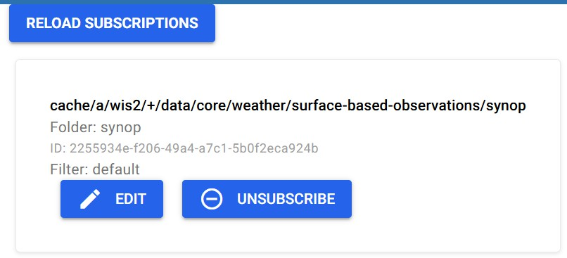
Deleting subscriptions.
Select
Click the Unsubscribe of the subscription to remove.
Result
Downloader stops consuming that topic · downloaded data is retained on disk.
Always consider cleaning up the downloads folder after removing a subscription.

Slide 20
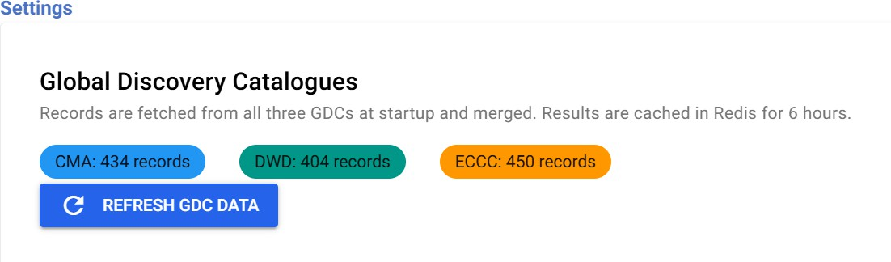
Reloading metadata records.
M ET AD AT A M AN AG EM ENT
Trigger
Click Refresh GDC Data in the Settings tab.
Effect
Re-fetches all WCMP2 records from the configured GDCs.
Result
Catalogue and Tree views refresh · new datasets become available immediately.

Slide 21
DEMO.
Installing wis2dowloader
https://training.wis2box.wis.wmo.int/practical-sessions/setting-up-wis2-downloader/

Slide 22
Thank You

